Slide 1

Tourify
Hong Wei Phang G00388774
Supervisor: Andrew Beatty

Slide 2
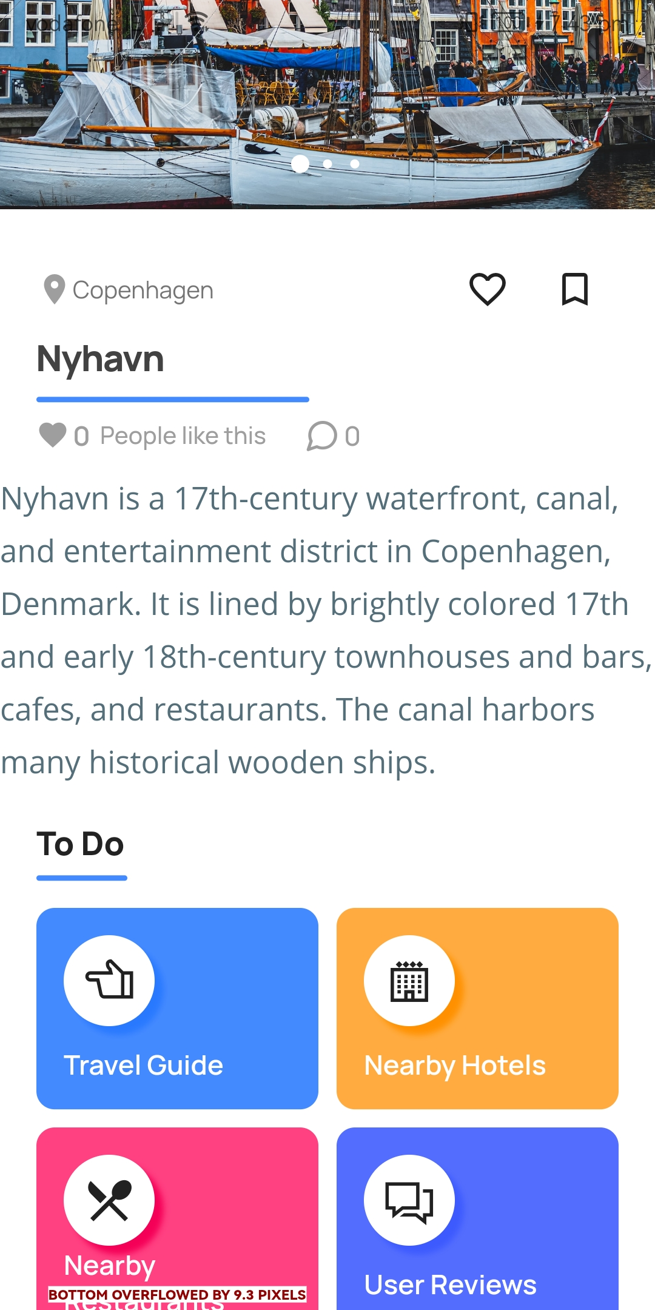
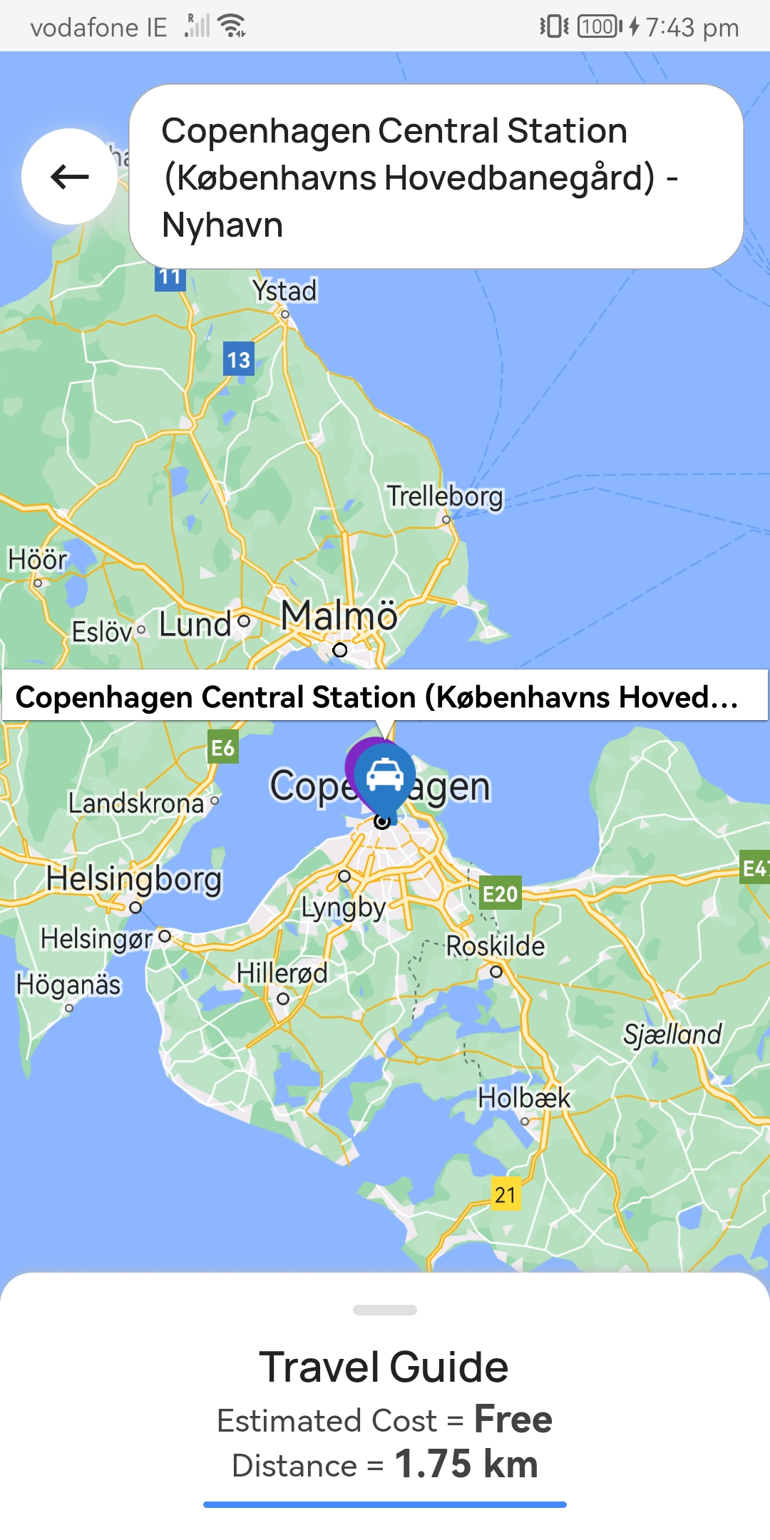
Context & Objectives
Context of the Problem Domain:
In an era where travel is increasingly accessible yet overwhelming due to the plethora of options, there's a need for a comprehensive, user-friendly travel guide app. This project addresses the gap in current travel apps by offering a one-stop solution for all travel needs, specifically tailored to a single country.
Why the Problem Domain is of Interest:
Travel planning is an integral part of the modern lifestyle, and enhancing this experience with technology can significantly impact how people explore and interact with new destinations.
Key Objectives of the Project:
Comprehensive Coverage: To provide extensive information on all major tourist attractions, hotels, and restaurants in the selected country.
User-Friendly Interface: Design an intuitive and easy-to-navigate app interface, suitable for users of all tech-savviness levels.
Real-Time Navigation and Local Info: Integrate real-time navigation and up-to-date local information using Google Maps APIs.
Engagement and Interaction: Incorporate features for user engagement, such as reviews, ratings

Slide 3
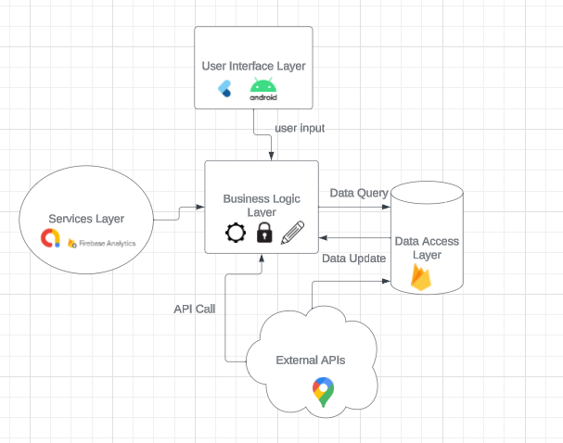
Technologies & System Architecture
Explanation of Chosen Technologies:
Flutter: Chosen for its ability to build natively compiled applications for mobile, web, and desktop from a single codebase, enhancing development efficiency and maintaining consistency across platforms.
Firestore Database: Selected for its real-time, cloud-hosted database capabilities, offering seamless data synchronization and offline support, crucial for a dynamic travel app.
Google Maps APIs: Integral for providing reliable and accurate mapping, navigation, and local place information, essential for any travel guide application.
Firebase Analytics: Utilized for its comprehensive app performance and user behavior tracking, which is vital for continuous improvement.
Admob & Facebook Ads: These platforms are incorporated for their wide reach and sophisticated targeting options, aiding in effective monetization of the app.

Slide 4
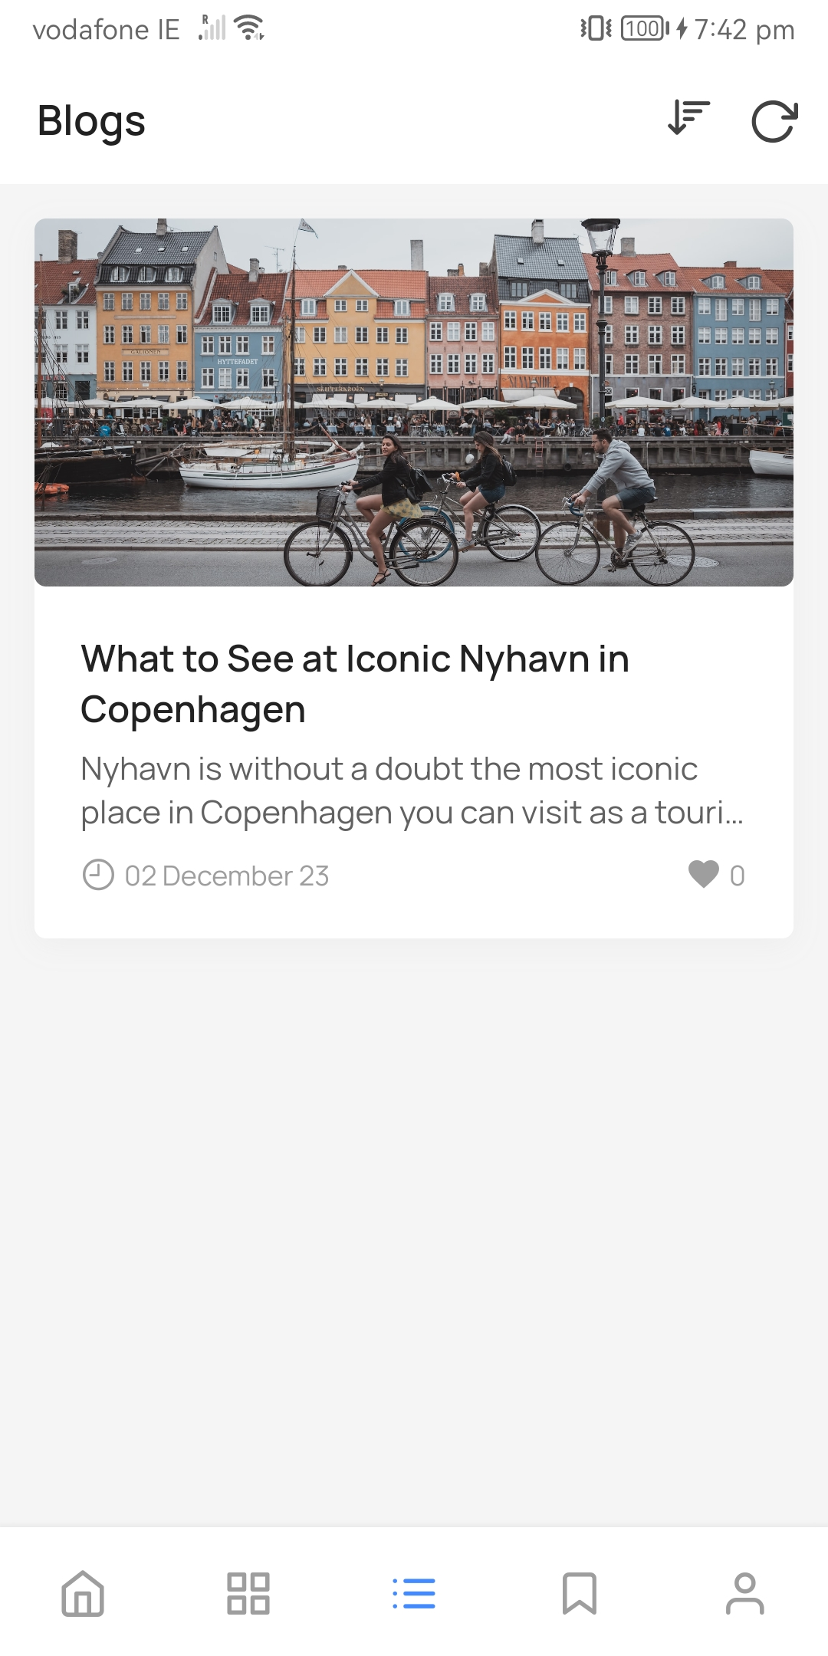
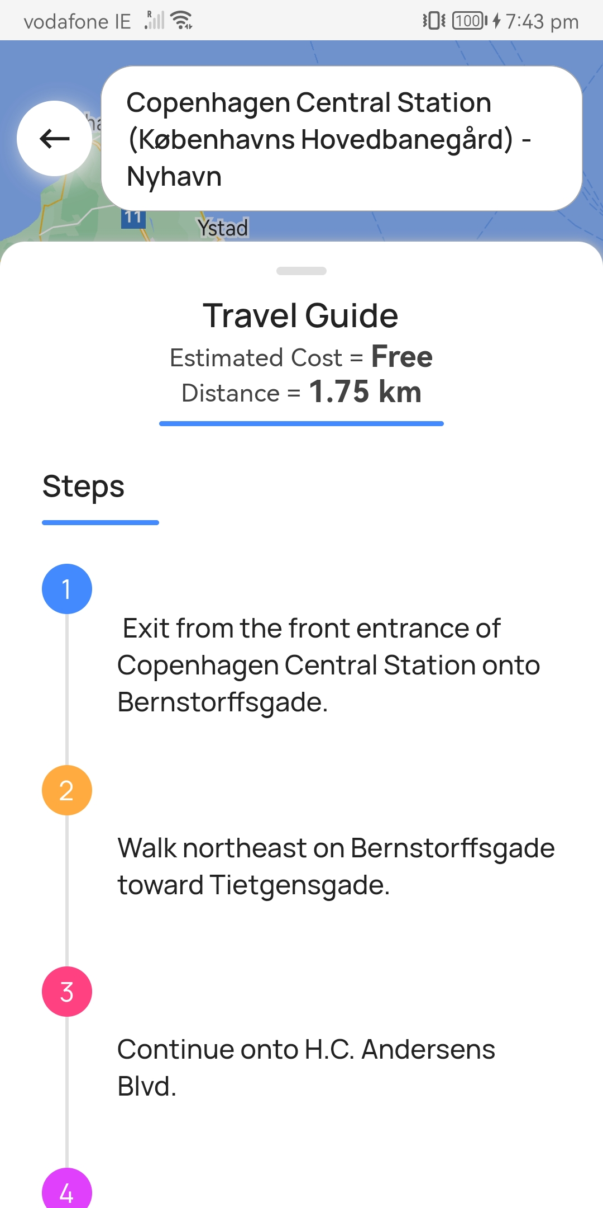
Methodology and Technical Features
1. User Authentication and Interaction:
Social Media Sign-In options (Google, Facebook).
Skip Sign-In feature for immediate app access.
2. Navigation and Location Services:
Travel Guide with detailed route, cost estimation, and step-by-step instructions.
Google Maps APIs (Android, Places, Direction) for comprehensive mapping.
3. Content and Data Management:
Travel Blogs.
Categories and Search features for easy navigation of content.
4. Backend and State Management:
Cloud Firestore Database for fast, easy, and secure data handling.
Provider for efficient state management.

Slide 5
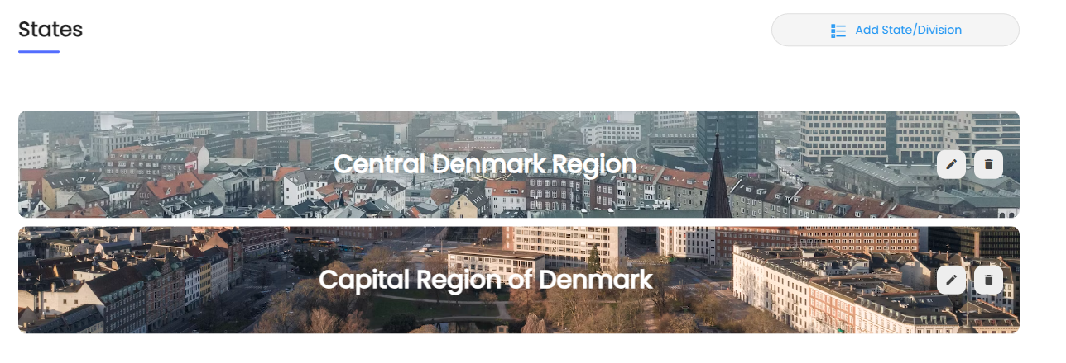
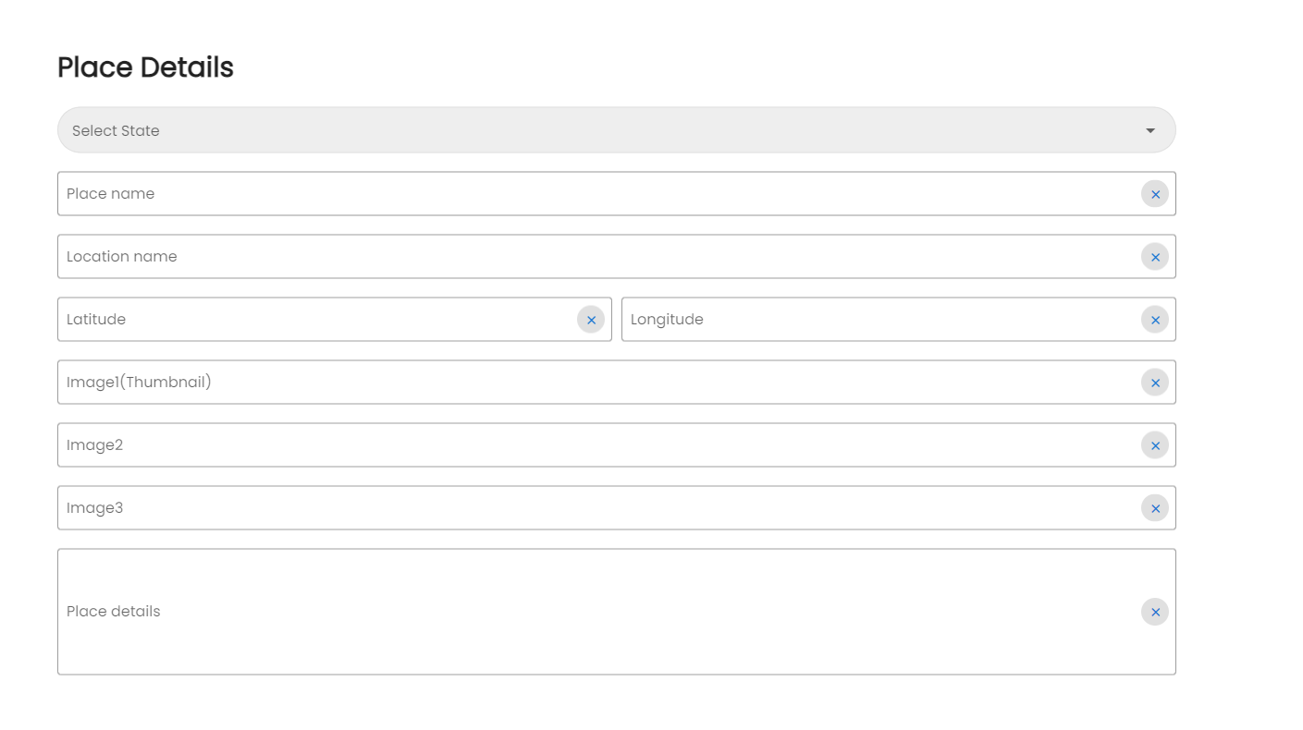
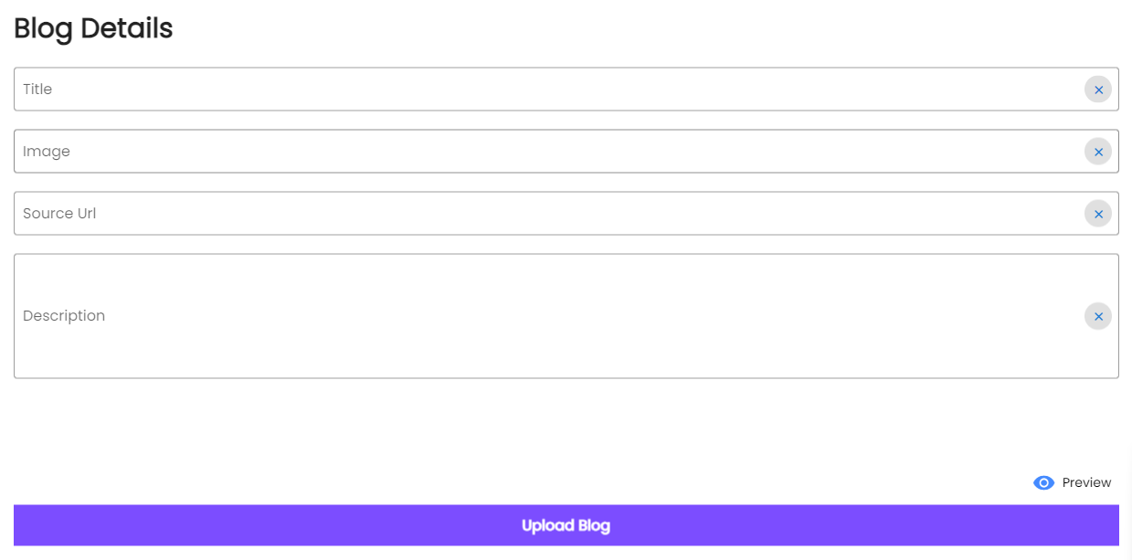
Admin Panel Features
Content Management:
Upload, Edit, Delete Features: Full control over places and blogs content, with a real-time preview option.
Control Featured Contents: Curate and modify featured content on the app.
Hosting and Backend:
Free Firebase Hosting: No need for additional domain or hosting services.
Cloud Firestore Backend: Reliable and secure data management.

Slide 6
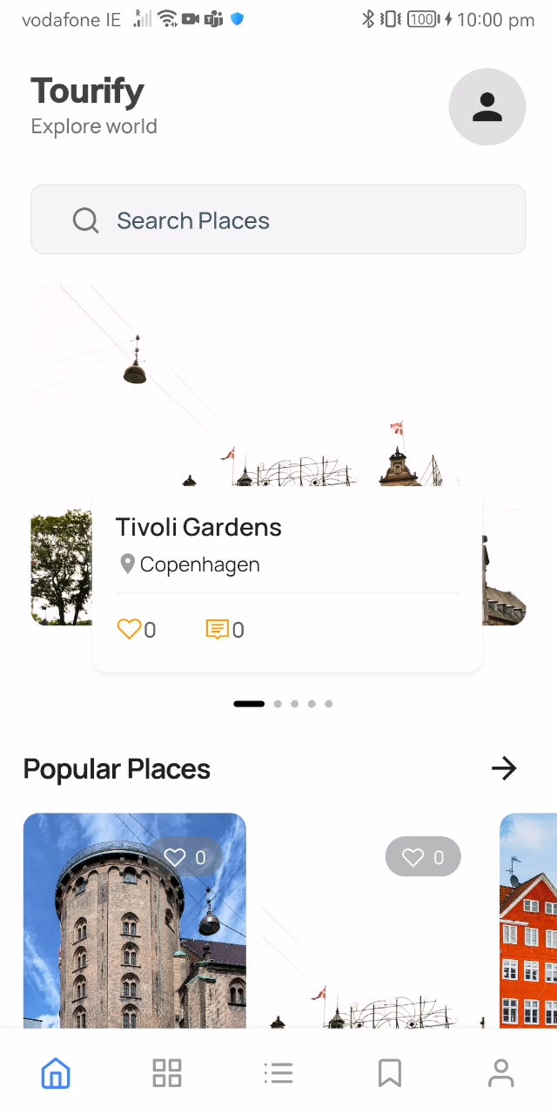

Slide 7
Conclusion and Future Directions
1. Enhanced User Interaction:
Social Features: Introduce a 'likes' and 'favorites' system to allow users to engage more interactively with the content (places, blogs, travel guides).
Review System Enhancement: Enable users to read and browse through reviews written by others, offering a more community-driven experience and informed decision-making.
2. Advanced Advertising Options:
Admob & Facebook Ads Integration: Implement interstitial ads from both Admob and Facebook, providing a diversified revenue stream.
Configurable Ad Settings: Develop the capability for ads to be fully configurable based on user clicks, enhancing the relevance and effectiveness of advertisements.
Admin Panel Control: Ensure ads can be monitored and controlled from the admin panel, allowing for real-time adjustments and optimization.
3. Data Analytics
Utilize data analytics to understand user engagement with the likes, favorites, and review features.

Slide 8
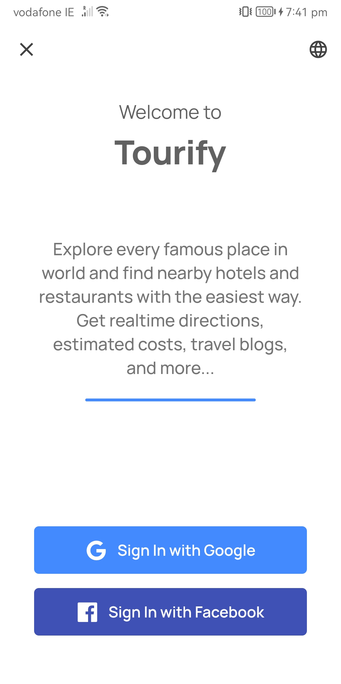
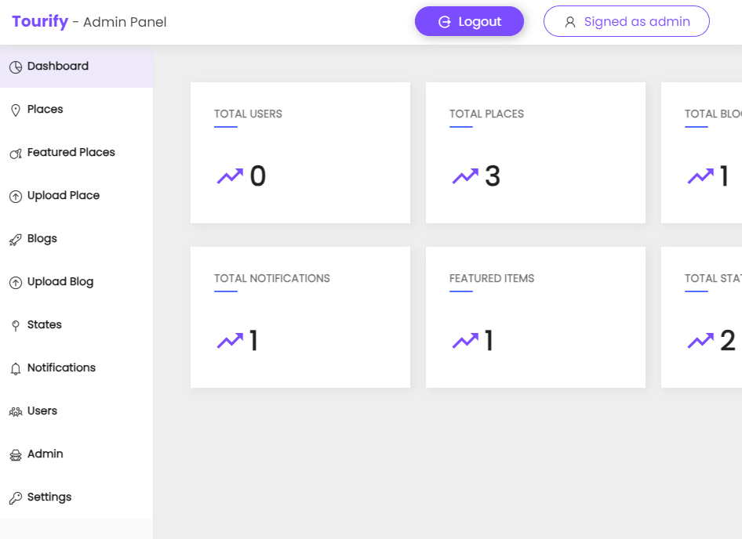
Inroduction
This project introduces a comprehensive travel guide application, focusing exclusively on a particular country, and is entirely built using Google's Flutter framework. The application features an administrative panel, also crafted with Flutter Web, ensuring compatibility across Android platforms.
For the backend, I have integrated Firestore Database, coupled with Provider for efficient state management.
Key functionalities include integration with Google Maps and its APIs, facilitating access to local information such as hotels and restaurants, and providing navigation routes from one point to another.

